Slide 1
Economic Growth Vs Economic Development
Dr. Sanda Thein(PHD)
Professor
Dept.of statistics
Yangon university of economic

Slide 2
Economic Growth
• Michael P. Todaro: Economic growth is a steady process by which the productive capacity of the economy is increased over time to bring about rising levels of national output and income.
• Simon Kuznets: Economic growth may be defined as a long term process where in the substantial and sustained rise in real national income, total population and real per capita income takes place.

Slide 3
Economic Development
• Michael P. Todaro: Development refers to a multi dimensional process involving major changes in social and institutional structures as well as the acceleration of eco-growth, poverty eradication and the reduction of inequality of wealth.
• It refers to increase in living standards, improvement in self-esteem needs, freedom from oppression, greater choice.
. Takes into account the size of the informal economy.

Slide 4
Features
Features of economic growth | Features of Economic Development
•Economic Growth implies process of increase in National Income and Per Capita income. • Economic Growth is measured by increase in Real National Income. • Increase in real income should be Over Long Period • Increase in income should be based on increase in Productive Capacity. | • The concept of economic development is based on sustained improvement in material well being of society. • Economic Development brins changes in supply of resources, rate of capital formation, technology, skill and efficiency, institutional and organizational setup.

Slide 5
Comparison between Economic Growth and Economic Development
 | Economic Growth | Economic Development
Meaning | Economic growth refers to an increase in the real output of goods and services in the country . | Economic development implies income , saving and investment along with progressive change in socio-economic structure of economy .

Slide 6
Comparison between Economic Growth and Economic Development
 | Economic Growth | Economic Development
Factors | Growth relates to gradual increase in one of the components of Gross Domestic Product: consumption, government spending, investment, net exports. | Development relates to growth of human capital, decrease in inequality figures and structural changes improve the quality of life of people.

Slide 7
Comparison between Economic Growth and Economic Development
 | Economic Growth | Economic Development
Measurement | Economic Growth is measured by quantitative factors such as increase in real GDP or per capita income. | The qualitative measurement such as HDI (Human Development Index), gender related index, Human poverty index, infant mortality, literacy rate etc are used to measure economic development.

Slide 8
Comparison between Economic Growth and Economic Development
 | Economic Growth | Economic Development
Effect: Relevance: | Economic growth brings quantitative changes in the economy Economic growth reflects the growth of national or per capita income | Economic development leads to qualitative as well as quantitative change in the economy. An economic development reflects progress in the quality of life in a country.

Slide 9
Key Differences
Economic Growth | Economic Development
• Positive change in the real output of the country in a particular span of time. • Economic growth is an automatic process • Enables an increase in the indicators like GDP, per capita income etc. | • Rise in the level of production along with the advancement of technology, improvement in living standards and so on. • The outcome of planned and result-oriented activities. • Enables improvement in the life expectancy rate, infant mortality rate, literacy rate and poverty rates etc.

Slide 10
Key Differences
Economic Growth | Economic Development
• Short-term process which takes into account yearly growth of the economy. • Mostly the problem of developed countries. • Results in quantitative changes. • Measured at a particular point of time. | • A long term and continuous process. • The main concern of developing countries. • Results in both quantitative and qualitative changes. • Measured over a period of time.

Slide 11
Conclusion
Economic development is a much bigger concept than economic growth.
Economic development includes economic growth.
Economic growth is a necessary but not sufficient development. condition of economic
While GDP indicates economic growth, economic development is gauged by Human Development Index (HDI)

Slide 12
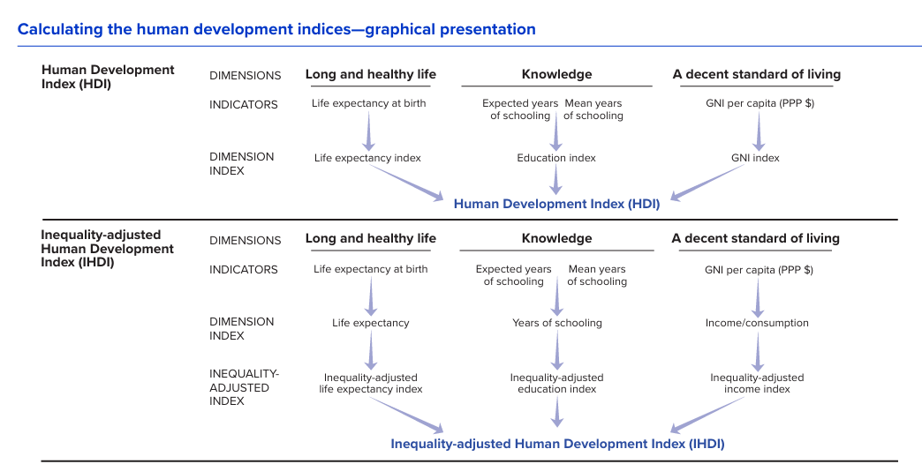
Human Development Index

Slide 13
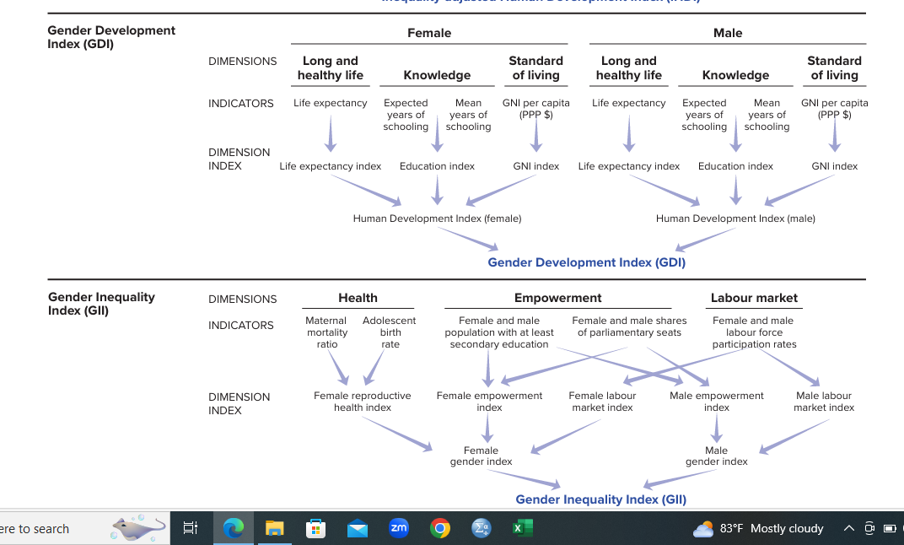

Slide 14
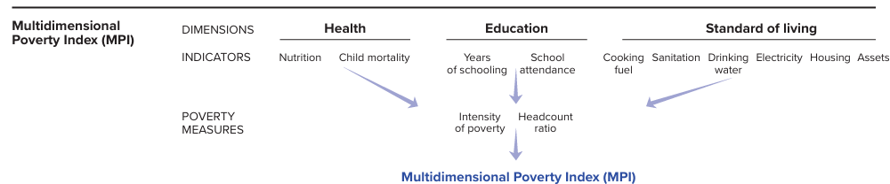

Slide 15
Human Development Index
The Human Development Index (HDI)
(1) a long and healthy life,
(2) access to knowledge and
(3) a decent standard of living.
The HDI is the geometric mean of normalized indices for each of the three dimensions.

Slide 16
Creating the dimension indices
Minimum and maximum values (goalposts) are set in order to transform the indicators expressed in different units into indices between 0 and 1.
These goalposts act as “the natural zeros” and “aspirational targets,” respectively, from which component indicators are standardized. They are set at the following values:
Dimension | Indicator | Minimum | Maximum
Health | Life expectancy at birth(years) | 20 | 85
Education | Expected years of schooling (years) | 0 | 18
 | Mean years of schooling (years) | 0 | 15
Standard of living | GNI per capita(2017ppp$) | 100 | 75,000

Slide 17

Dimension Index = $\frac{Actual value\left(X_{i}\right)−minimum value\left({MinX}_{i}\right)}{maximum value\left({MaxX}_{i}\right)−minimum value\left({MinX}_{i}\right)}$
HDI is the geometric mean of the three dimensional indeces:
HDI = ${(I_{Heath}∗ I_{Education}∗I_{Income})}^{1/3}$

Slide 18
Example: Guyana
Indicator | Value
Life expectancy at birth (years) | 65.7
Expected years of schooling (years) | 12.5
Mean years of schooling (years) | 8.6
Gross national income per capita(2017 ppp$) | 22465

Slide 19
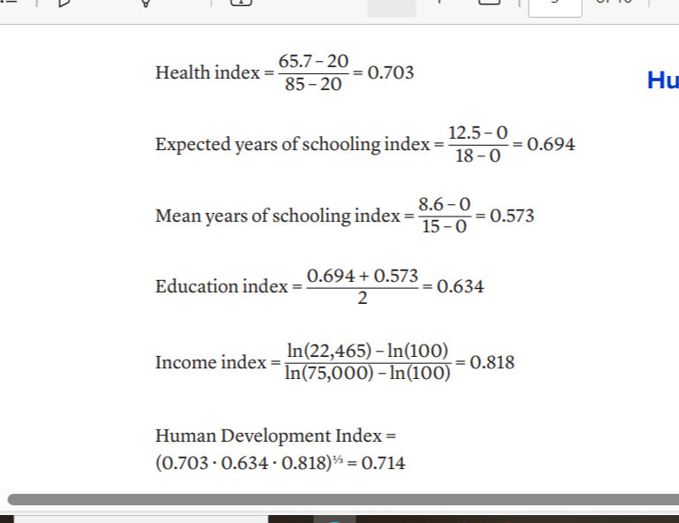

Slide 20
Inequality-adjusted Human Development Index
The Inequality-adjusted Human Development Index (IHDI) adjusts the Human Development Index (HDI) for inequality in the distribution of each dimension across the population.
The IHDI accounts for inequalities in HDI dimensions by “discounting” each dimension’s average value according to its level of inequality.
The IHDI value equals the HDI value when there is no inequality across people but falls below the HDI value as inequality rises.

Slide 21

Estimating inequality in the three dimensions of the Human Development Index
The IHDI draws on the Atkinson (1970) family of inequality measures and sets the aversion parameter ε equal to 1.1 In this case the inequality measure is A = 1– g/μ, where g is the geometric mean and μ is the arithmetic mean of the distribution. This can be written as:
$A_{x}$ = 1- $\frac{\sqrt[n]{X_{1}…X_{n})}}{\overline{X}}$
where {$X_{1}$ , … , $X_{n}$ } denotes the underlying distribution in the dimension of interest. $A_{x}$ is obtained for each variable (life expectancy, mean years of schooling and disposable household income or consumption per capita)

Slide 22

Adjusting the dimension indices for inequality
The inequality-adjusted dimension indices are obtained from the HDI dimension indices, $I_{x}$ , by multiplying them by (1 – $A_{x}$ ), where $I_{x}$ , defined by equation 1, is the corresponding Atkinson measure:
$I_{x}^{∗}$ = (1 – $A_{x}$ ) . $I_{x}$
The inequality-adjusted income index $I_{income}^{∗}$, is based on the index of logged income values,$I_{income}$ , and inequality in income distribution computed using income in levels. This enables the IHDI to account for the full effect of income inequality.

Slide 23

Combining the dimension indices
The IHDI is the geometric mean of the three dimension indices adjusted for inequality:
IHDI = ${(I_{Health . }^{∗}I_{Education }^{∗}{. I}_{Income}^{∗})}^{1/3}$=
[(1 – $A_{Health}$ ) . (1 – $A_{Education}$ ) . (1 – $A_{Income}$ ) ]1/3 . HDI.
Loss = 1 - [(1 – $A_{Health}$ ) . (1 – $A_{Education}$ ) . (1 – $A_{Income}$ )]1/3

Slide 24

Coefficient of human inequality
An unweighted average of inequalities in health, education and income is denoted as the coefficient of human inequality. It averages these inequalities using the arithmetic mean:
Coefficient of human inequality = $\frac{{A_{Health}}_{+} A_{Education}+A_{Income}}{3}$
When all inequalities in dimensions are of a similar magnitude, the coefficient of human inequality and the loss in HDI value differ negligibly. When inequalities differ in magnitude, the loss in HDI value tends to be higher than the coefficient of human inequality

Slide 25
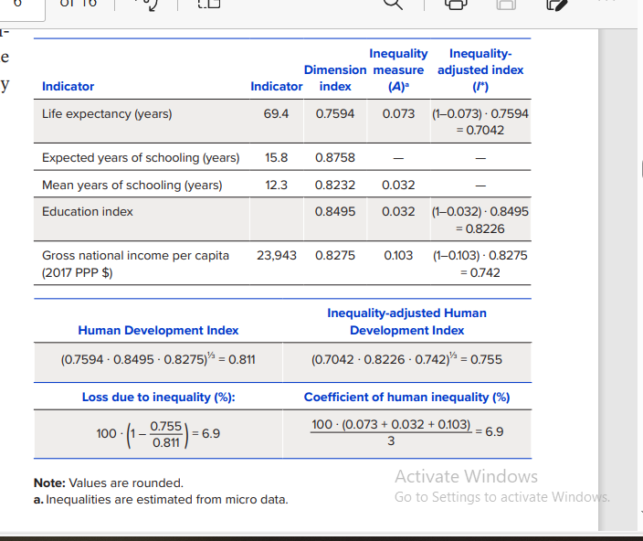
Example: Kazakhstan

Slide 26
Gender Development Index
The Gender Development Index (GDI) measures gender inequalities in achievement in three basic dimensions of human development:
health, measured by female and male life expectancy at birth;
education, measured by female and male expected years of schooling for children and female and male mean years of schooling for adults ages 25 years and older;
and command over economic resources, measured by female and male estimated earned income.

Slide 27

Estimating female and male earned incomes
To calculate estimated earned incomes, the share of the wage bill is calculated for each gender. The female share of the wage bill (Sf ) is calculated as follows:
$S_{f}$ = $\frac{{W_{f}}/{W_{m} . { EA}_{f}}}{{W_{f}}/{W_{m} . {EA}_{f}}+{EA}_{f}}$
where ${W_{f}}/{W_{m} . }$ is the ratio of female to male wage, ${EA}_{f}$is the female share of the economically active population and ${EA}_{m}$is the male share. The male share of the wage bill is calculated as
$S_{m}$ = 1 - $S_{f}$

Slide 28

Estimated female earned income per capita (${GNI}_{{pc}_{f}}$) is obtained from GNI per capita (${GNI}_{pc}$), first by multiplying it by the female share of the wage bill, Sf , and then rescaling it by the female share of the population, $P_{f}$=$\frac{N_{f}}{N}$:
${GNI}_{{pc}_{f}}$ = ${GNI}_{pc}$ . $\frac{S_{f}}{P_{f}}$ .
Estimated male earned income per capita is obtained in the same
Way: ${GNI}_{{pc}_{m}}$ = ${GNI}_{pc}$ . $\frac{S_{m}}{P_{m}}$
where Pm = 1 – Pf is the male share of population.

Slide 29
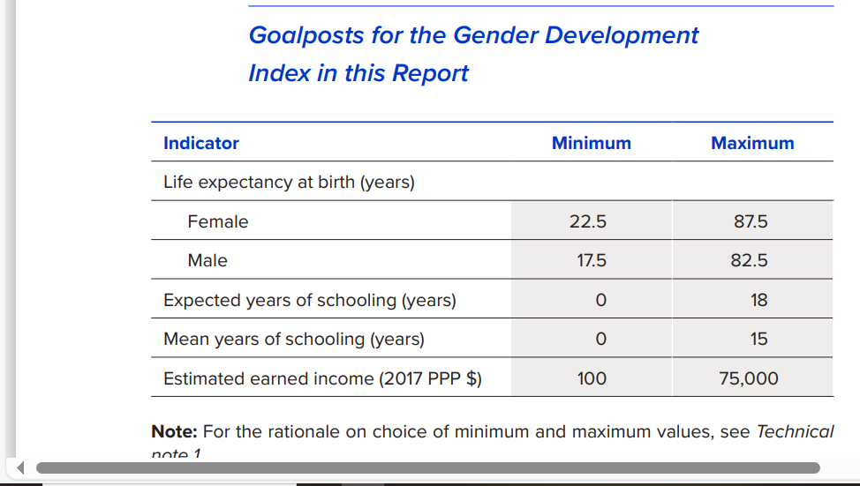

Slide 30

Calculating the female and male Human Development Index values
The female and male HDI values are the geometric means of the three dimensional indices for each gender:
${HDI}_{f}$ = ${(I_{Heath(f)}∗ I_{Education(f)}∗I_{Income(f)})}^{1/3}$
${HDI}_{m}$ = ${(I_{Heath(m)}∗ I_{Education(m)}∗I_{Income(m)})}^{1/3}$

Slide 31

Comparing female and male Human Development Index values
The GDI is simply the ratio of female HDI value to male HDI value to male HDI value:
GDI = $\frac{{HDI}_{f}}{{HDI}_{m}}$

Slide 32
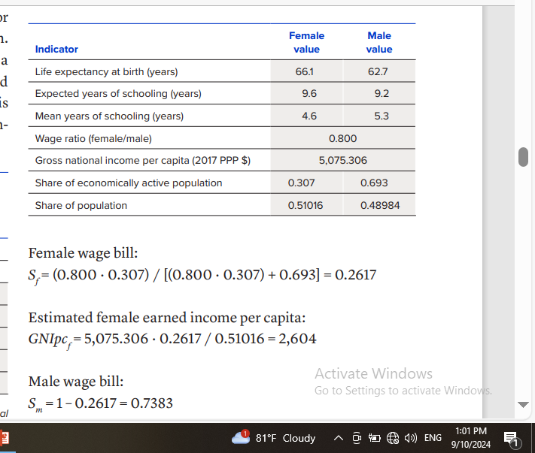
Example: Mauritania

Slide 33
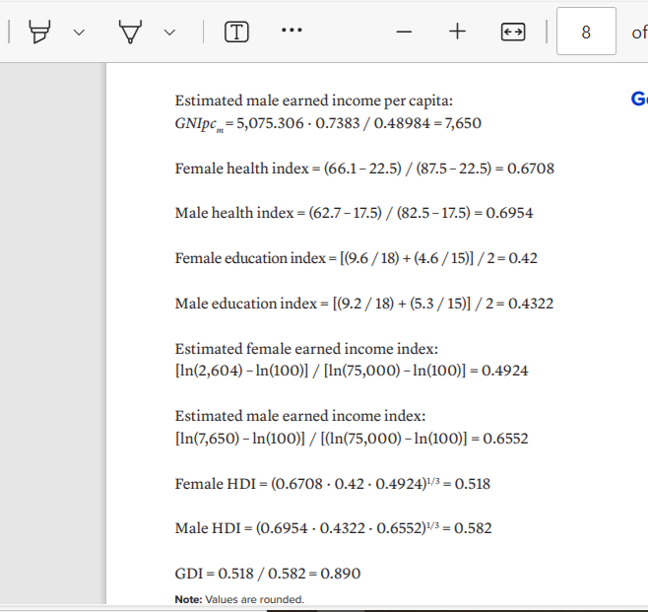

Slide 34
Gender Development Index groups
The GDI groups are based on the absolute deviation of GDI from gender parity, 100 ∙ |GDI – 1|.
Countries with absolute deviation from gender parity of 2.5 percent or less are considered countries with high equality in HDI achievements between women and men and are classified as group 1.
Countries with absolute deviation from gender parity of 2.5–5 percent are considered countries with medium-high equality in HDI achievements between women and men and are classified as group 2.

Slide 35
Gender Development Index groups
Countries with absolute deviation from gender parity of 5–7.5 percent are considered countries with medium equality in HDI achievements between women and men and are classified as group 3.
Countries with absolute deviation from gender parity of 7.5–10 percent are considered countries with medium-low equality in HDI achievements between women and men and are classified as group 4.
Countries with absolute deviation from gender parity of more than 10 percent are considered countries with low equality in HDI achievements between women and men and are classified as group 5

Slide 36
Gender Inequality Index
The Gender Inequality Index (GII) reflects gender-based disadvantage in three dimensions—
reproductive health,
empowerment and
the labour market
It shows the loss in potential human development due to inequality between female and male achievements in these dimensions.
It ranges from 0, where women and men fare equally, to 1, where one gender fares as poorly as possible in all measured dimensions.

Slide 37

Aggregating across dimensions within each gender group, using geometric means
For women and girls the aggregation formula is:
$G_{f}= \sqrt[3]{({\frac{10}{MMR} .\frac{1}{ABR})}^{1/2} .({{PR}_{f} . {SE}_{f})}^{1/2}.{LFPR}_{f} }$
and for men and boys the formula is
$G_{m}= \sqrt[3]{1.({{PR}_{m} . {SE}_{m})}^{1/2}.{LFPR}_{m} }$
The rescaling by 0.1 of the maternal mortality ratio in equation 1 is needed to account for the truncation of the maternal mortality ratio at 10

Slide 38

Aggregating across gender groups, using a harmonic mean
The female and male indices are aggregated by the harmonic mean to create the equally distributed gender index
HARM($G_{f}$, $G_{m}$) = ${\left[\frac{G_{f}^{−1}+G_{m}^{−1}}{2}\right]}^{−1}$
Using the harmonic mean of within-group geometric means captures the inequality between women and men and adjusts for association between dimensions—that is, it accounts for the overlapping inequalities in dimensions.

Slide 39

The reference standard for computing inequali ty is obtained by aggregating female and male indi ces using equal weights (thus treating the genders equally) and then aggregating the indices across dimensions:
$G_{F,M}$= $\sqrt[3]{\overline{Health},\overline{Empowerment},\overline{LEPR}}$
Where $\overline{Health}$ = $\left(\sqrt{\frac{10}{MMR}. \frac{1}{ABR}}+1\right)/2$
$\overline{Empowerment}$ = $\left(\sqrt{{PR}_{F}.{SE}_{F}}+\sqrt{{PR}_{M}. {SE}_{M}}\right)/2$
$\overline{LEPR}$ = $\frac{{LFPR}_{F}+{LFPR}_{M}}{2}$

Slide 40

Comparing Indices
Comparing the equally distributed gender index to the reference standard yields the GII,
GII = 1 - $\frac{HARM (G_{F },G_{M})}{G_{F,M}}$

Slide 41
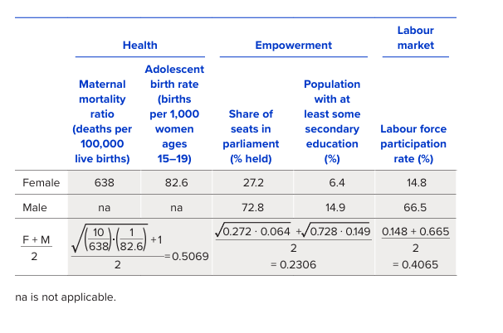
Example: Afghanistan

Slide 42

$G_{f}= \sqrt[3]{({\frac{10}{MMR} .\frac{1}{ABR})}^{1/2} .({{PR}_{f} . {SE}_{f})}^{1/2}.{LFPR}_{f} }$
$G_{f}= \sqrt[3]{({\frac{10}{638} .\frac{1}{82.6})}^{1/2} .({0.272 .0.064)}^{1/2}.0.148 }$= 0.0646
$G_{m}= \sqrt[3]{1.({{PR}_{m} . {SE}_{m})}^{1/2}.{LFPR}_{m} }$
$G_{m}= \sqrt[3]{1.({0.728 .0.149)}^{1/2}.0.665 }$ = 0.6028
HARM($G_{f}$, $G_{m}$) = ${\left[\frac{{0.0646}_{}^{−1}+{0.6028}_{}^{−1}}{2}\right]}^{−1}$= 0.1167
$G_{F,M}$= $\sqrt[3]{0.5069, 0.2306, 0.4065 }$ = 0.3622
GII = 1 - $\frac{HARM (G_{F },G_{M})}{G_{F,M}}$ = 1- $\frac{0.1167}{0.3622}$ = 0.678.

Slide 43
Multidimensional Poverty Index
The global Multidimensional Poverty Index (MPI) identifies multiple deprivations at the household level in health, education and standard of living.
Each person is assigned a deprivation score accord ing to his or her household’s deprivations in each of the 10 indicators.
The maximum deprivation score is 100 percent, with each dimension equally weighted; thus, the maximum deprivation score in each dimension is 33.3 percent or, more accurately, 1/3.
The health and education dimensions have two indicators each, so each indicator is weighted as 1/6.
The standard of living dimension has six indicators, so each indicator is weighted as 1/18.

Slide 44
To identify multidimensionally poor people, the deprivation scores for each indicator are summed to obtain the household deprivation score.
A cutoff of 1/3 is used to distinguish between poor and nonpoor people. If the deprivation score is 1/3 or higher, that household (and everyone in it) is considered multi dimensionally poor.
People with a deprivation score of 1/5 or higher but less than 1/3 are considered to be vulnerable to multidimensional poverty.
People with a deprivation score of 1/2 or higher are considered to be in severe multidimensional poverty.

Slide 45

The headcount ratio, H, is the proportion of multi dimensionally poor people in the population:
H = $\frac{q}{n}$
where q is the number of people who are multidimensionally poor and n is the total population.

Slide 46

The intensity of poverty, A, reflects the average proportion of the weighted component indicators in which multidimensionally poor people are deprived.
For multidimensionally poor people only (those with a deprivation score s greater than or equal to 33.3 per cent), the deprivation scores are summed and divided by the total number of multidimensionally poor people:
A = $\frac{\sum_{1}^{q}{S_{i}}}{q}$
where $S_{i}$ is the deprivation score that the ith multidimensionally poor person experiences.

Slide 47

The deprivation score si of the ith multidimensionally poor person can be expressed as the sum of the weights associated with each indica tor j (j = 1, 2, ..., 10) in which person i is deprived,
$S_{i}$ = $c_{i1}$ + $c_{i2}$ + … + $c_{i10}.$

Slide 48

The MPI value is the product of two measures: the multidimensional poverty headcount ratio and the intensity of poverty:
MPI = H . A
The contribution of dimension d to multidimensional poverty can be expressed as:
${Contrib}_{d}$ = $\frac{\sum_{j∈d}{\sum_{1}^{q}{c_{ij}}}}{n}$ / MPI
where d is health, education or standard of living.

Slide 49

The MPI can also be expressed as the weighted sum of the censored headcount rates hj of each indicator j.
The censored headcount rate of indicator j refers to the proportion of people who are multidimensionally poor and deprived in this indicator.
MPI =$\sum_{j=1}^{10}{c_{j}h_{j}}$
where $c_{j}$ is the weight associated with indicator j (either 1/6 or 1/18), and the weights sum to 1.

Slide 50

The variance of deprivation scores of multidimensionally poor people is used to measure inequality among those people:
V = $\sum_{1}^{q}{({s_{i}−A)}^{2}}$/(q-1)
All parameters defined above are estimated using survey data and sampling weights according to the rules of the sampling theory (Lohr 2010).

Slide 51
Weighted deprivations: •
Household 1: (1 . 16.67) + (1 . 5.56) = 22.2 percent. •
Household 2: 72.2 percent. •
Household 3: 38.9 percent. •
Household 4: 50.0 percent.

Slide 52
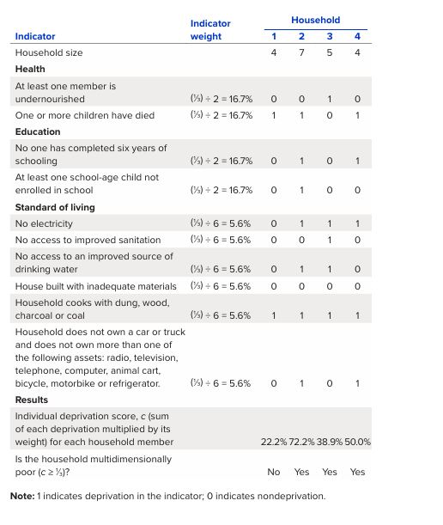

Slide 53

Based on this hypothetical population of four households:
Headcount ratio(H) = $\frac{0+7+5+4}{4+7+5+4}$ = 0.80
(80 percent of people are multidimensionally poor)
Intensity of poverty
(A) = $\frac{\text{(72.2 . 7) + (38.9 . 5) + (50.0 . 4) ( 7 + 5 + 4 )}}{7+5+4}$ = 56.3 percent
(the average multidimensionally poor person is de prived in 56.3 percent of the weighted indicators).

Slide 54

MPI = H*A= 0.8 * 0.563 = 0.450
Contribution of deprivations in:
Health:
${contrib}_{1}=\frac{16.67+16.67+(7+4)}{4+7+5+4}$ / 0.450 = 29.6%
Education:
${contrib}_{2}=\frac{16.67∗\left(7+4\right)+16.67∗7}{4+7+5+4}$ / 0.450 = 33.3%
Standard of Living:
${contrib}_{3}=\frac{5.56∗(7∗4+5∗4+4∗3)}{4+7+5+4}$ / 0.450 = 37.1%

Slide 55

Variance of deprivation scores among the poor (V) =
$\frac{{\text{(0.722 – 0.563)}}^{2}∗7+{\text{(0.389 – 0.563)}}^{2}∗5+{\text{0.500 – 0.563})}^{2}∗4 }{16−1}$= 0.023

